Slide 1


01
Your Business Name
MARKETING PRESENTATION
VERSION 2.0 - 2020
Your quick, catchy tagline here

Slide 2

02

Slide 3

Your Name
BRIEFLY INTRODUCE YOURSELF.
Presentations are communication tools
that can be used as demonstrations.
BE FUN AND CREATIVE WITH
YOUR INTRODUCTION.
Presentations are communication tools
that can be used as demonstrations.
03

Slide 4

04
Brief story
HOW YOUR BUSINESS COME ALONG
Presentations are tools that can be used as demonstrations, lectures, speeches, reports, and more. It serves a variety of purposes, making presentations powerful tools for convincing and teaching.
MARKETING PRESENTATION

Slide 5

05

Slide 6

Write a brief description.
Presentations are communication tools
that can be used as demonstrations, speeches, reports, and more. It is mostly presented before an audience.
06

Slide 7

Product 2
Write a brief description.
07

Slide 8

08

Slide 9

09

Slide 10
10

Slide 11
11

Slide 12

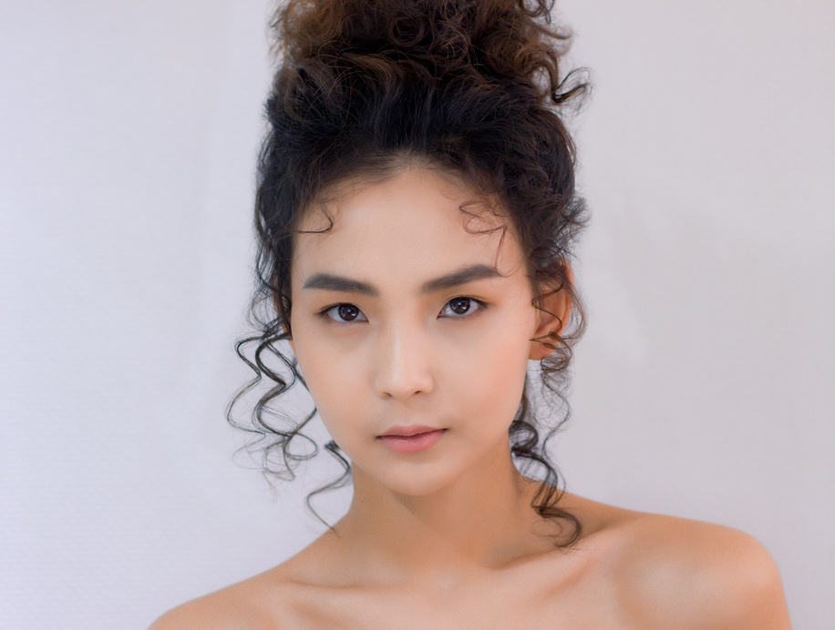

12
Customer reviews
Customer name
Customer name
Customer name
Presentations are tools that can be used as reports, and more.
Presentations are tools that can be used as reports, and more.
Presentations are tools that can be used as reports, and more.

Slide 13


Bazaars
you've joined
Or stores if any.
BAZAAR 1
BAZAAR 2
BAZAAR 3
13

Slide 14

14
Follow me
FACEBOOK
@reallygreatsite
TWITTER
MARKETING PRESENTATION
@reallygreatsite
INSTAGRAM
@reallygreatsite

Slide 15

15
Get in touch
For inquiries or
anything under the sun
EMAIL
hello@reallygreatsite.com
WEBSITE
VERSION 2.0 - 2020
www.reallygreatsite.com
PHONE NUMBER
123-456-7890

